Slide 1

CISM 190: Intro to Tech
March 2017
Week 1

Slide 2
Agenda for today
Introductions
Syllabus & Course Contract
Unloop Overview
Computers & the Internet
Fundamental Programming Concepts
Lab: Blockly 1
Readings assigned: Internet of Things (IoT)

Slide 3
Introductions
Syllabus
Course Contract

Slide 4
Unloop Program Overview
Mission: Enable people who have been in prison to succeed in careers in tech
What Unloop does:
Education programs
Mentorship
Employer Network
Program at Monroe Correctional Complex
1 year, 40 credit certificate program in web development
Teaches skills you would need to be entry level web developer
Workshops & events with industry professionals
Selection criteria = 75% formula & 25% discretionary:
Grade in Intro to Tech Careers (50%)
Written application (30%)
Computer basics & logic assessment (20%)

Slide 5
Class discussion rules
There are no stupid questions
Learning is the objective
Everyone learns together
Help each other

Slide 6
What to expect
This class covers a very broad topic – tech and programming
You’ll get a sense of what you’re interested in and would like to learn more about
I don’t know everything, and neither will you
Have fun! (and ask questions)

Slide 7
Today’s discussion
What is the tech industry & why does it matter?
Computers from the bits up: Hardware and Software
Intro to the Internet
Foundation programming concepts

Slide 8
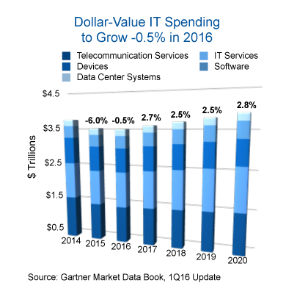
What is Technology? What is the “Tech Industry”?
Technology: the use of science in industry, engineering, etc., to invent useful things or to solve problems
Tech Industry: hardware, software, services

Slide 9
What is the first thing that comes to mind when you think of computer programming?

Slide 10

Computer Programming

Slide 11
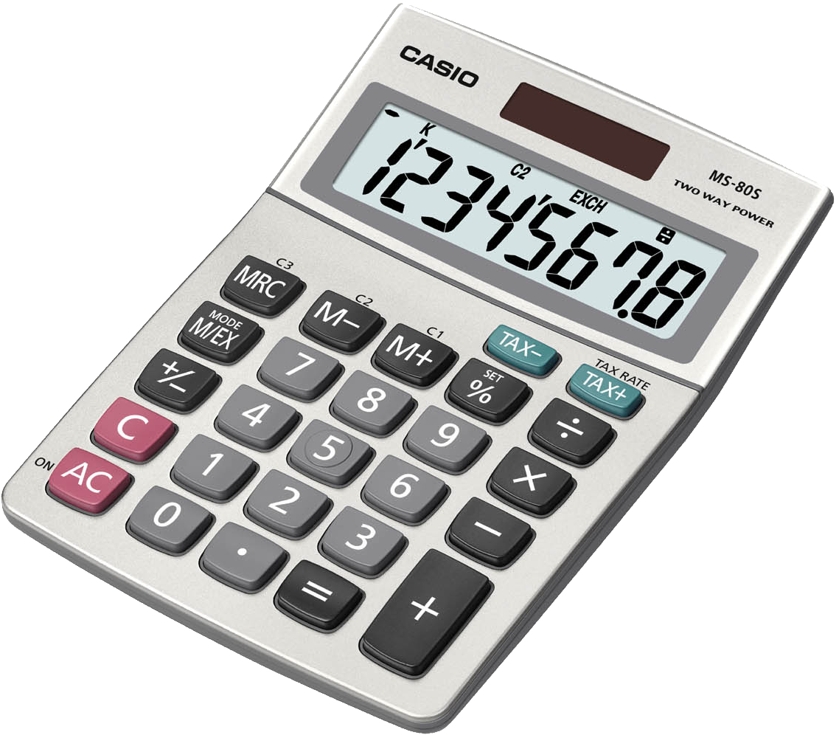


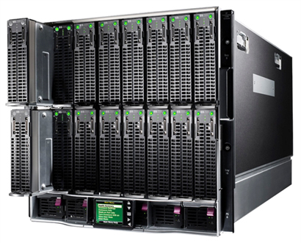
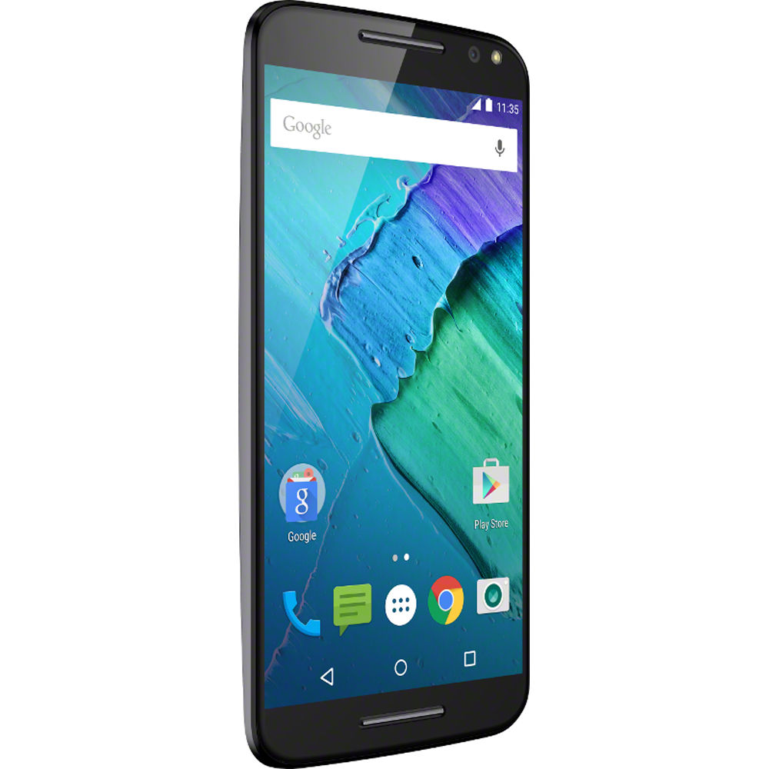
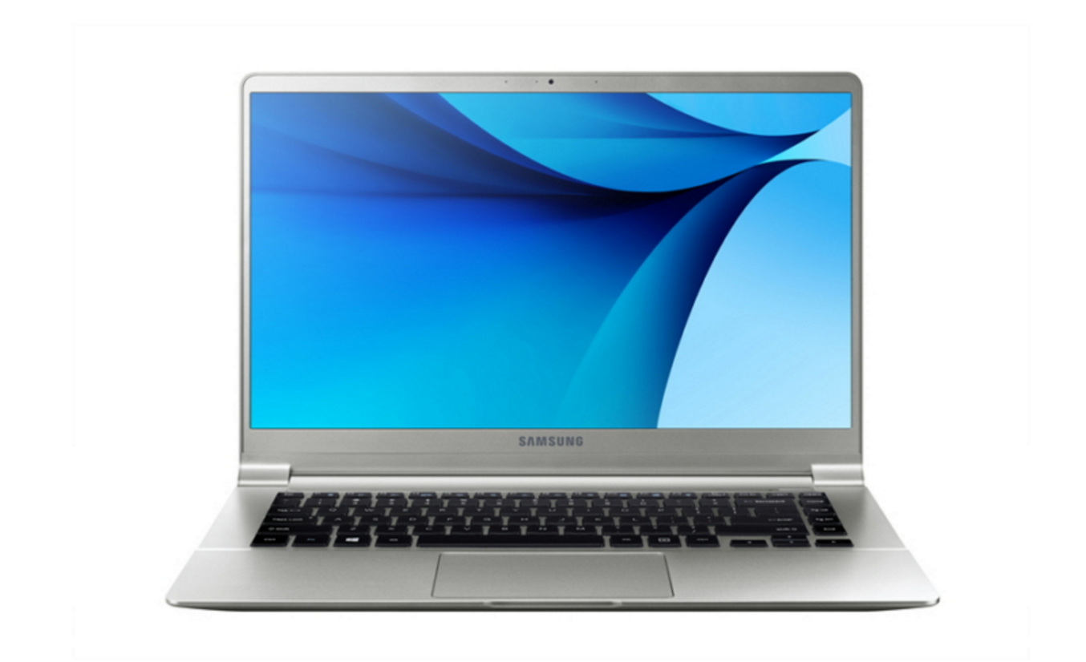
What is a computer?
Computer: An electronic device that stores and manipulates information – a computer is a counting device!
Notes:
Mikey

Slide 12
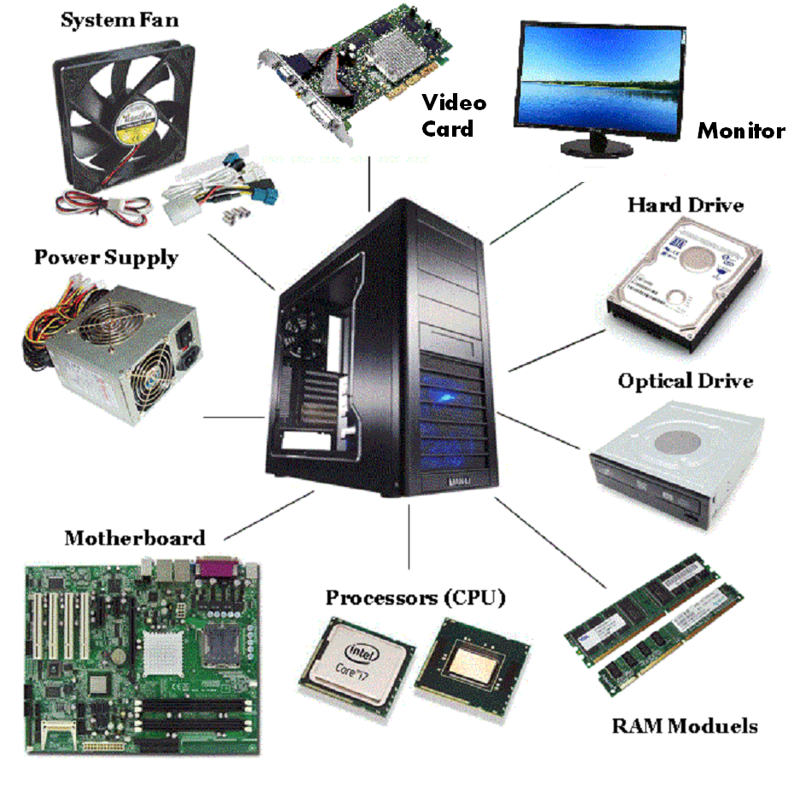

Hardware vs. Software
Focus of this class
Hardware: the physical parts of a computer system
Software: the set of instructions & stored data that make computers useful

Slide 13
How does software work?
When software “runs” on computer hardware, it’s using electric pulses (a lot of them!) to represent information on a computer’s circuits
Binary: Electric pulses (often represented by 1’s and 0’s) that make up the information that is stored & processed by a computer
Bits, bytes, kilobytes, megabytes, gigabytes, etc.
Quick translation: “b” in English = 01100010 in binary!
When someone uses it for programming = “machine code”
Programming language: an almost-English language that helps someone tell a computer what to do
Simpler than trying to write in binary (they used to do stuff like that!)
Examples: HTML, JavaScript, Python, Ruby, etc.
Program: a set of instructions for a computer, written in a programming language

Slide 14
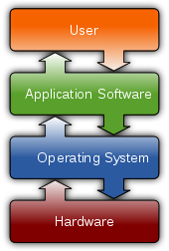
Important types of software
Operating system: performs basic tasks, such as recognizing input from the keyboard, sending output to the display screen, and launching applications
Examples?
Application: a program that runs on an operating system
Examples?
Browser: A specific type of application that processes and displays HTML files
Examples?

Slide 15

Notes:
Video on how the internet works
Walk through steps

Slide 16
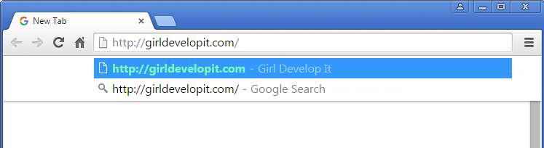
What happens when I visit a website?
Step 1: Type an address into the search bar in your browser

Slide 17
What happens when I visit a website?
Step 2: Your computer performs a DNS lookup
Each website has a unique code, called an IP address, that is like a phone number
DNS (or domain name servers), are like phone books. The DNS servers will connect you to the right server
girldevelopit.com → 205.178.189.129
Step 3: Your computer connects to the server
Your computer uses that IP address to find the correct web server and sends a request for a page

Slide 18
What happens when I visit a website?
Step 4: The server responds to your request
The server processes your request and finds the right files. Sometimes it has to "compile" a page from code and other sources, like a database.
Step 5: The server sends your computer the files
This is usually an HTML page, with some CSS, JavaScript, or media files.
Step 6: Your browser displays the files
Your browser interprets the code and assembles all the files into a page you can see and use. Each browser does this slightly differently.

Slide 19

Important internet concepts
Client: Accesses services (e.g. an HTML file) made available by a server
Server: provides services for other programs or devices (client)
HTTP: hyper-text transfer protocol – the rules for how to send data over the internet
IP address: the unique number of a computer connected to the internet

Slide 20
Basic Programming Concepts
Refresh: What is a computer program?
Blockly programs will teach:
If/Else Statements
For Loops
While Loops
Variables (we will cover this next session)
Why Blockly:
We don’t have to worry about Syntax!
Syntax: Spelling and correct formatting of code

Slide 21
If Statement
Test a Condition, and execute a statement(s) based on that condition.
If an obstacle is on the right, turn left.
If/Else Statement:
An If Statement, with a “Else Clause” attached. The “Else Clause” allows the program to take an action when the condition is NOT true
If an obstacle is on the right, turn left. Otherwise, go forward.
Nested If Statement:
Checks several conditions, one after another, and executes statement (s) based on those conditions
If an obstacle is on the right, turn left, else if obstacle is on the left, flash red lights. Otherwise go forward.

Slide 22
For Loop
Repeat a section of code a number of times
Example:
Walk forward 5 steps, turn left. Repeat 4 times.

Slide 23
While Loop
Similar to a For Loop, a While Loop lets a section of code be repeated.
A While Loop repeats the code, while a condition exists
Example:
While obstacles are in front of the robot, flash red lights.
While location does not equal destination, walk forward.
Discussion: what would happen if we had a while loop with a condition that was always true?

Slide 24
Programming is a different type of Edu
Embrace “failure” – it’s part of the process
Learn to be at home with not knowing, but stay curious!
Collaboration is encouraged – don’t reinvent the wheel, work together
There is rarely one solution to a problem – be creative
Experiment with different types of problem solving

Slide 25
TSA (think, search, ask) approach to problem solving
Think:
What is the problem I am having?
What do I know about the problem?
What do I not know about the problem?
What could I try on my own to solve the problem?
If I can’t solve it after some effort, how can I phrase it as a question? (be as specific as possible)
Search
What resources do I have where I could get information about my question?
Do any of the resources I can access have information that can answer my question?
If not, do any resources have information that allow me to make my question more specific?
Ask
Do any of the people around me know the answer to my question?
If not, have any of the people around me run into the same problem?
Do any of the people around me have information that allow me to make my question more specific?
Last step: ask a TA or your teacher!
Why?
This is how people will expect you to solve problems in tech
Fewer bottlenecks when you are asking for help
People will be happier to help you
Clearly stating problems is an invaluable skill
Be mindful of:
Time: don’t just bang your head against the wall for forever, if you’re stuck, it’s ok to ask!
Collaboration: be eager to help and be helped! If someone helps you along the way, share what you learn

Slide 26
Blockly Intro

Slide 27
For the rest of today:
Log into Moodle, find your folder on the drive & let me know of any problems
Get set-up on Blockly
Complete Maze and Bird Exercise through exercise 8 each
When you are complete with each exercise, please call me over so I can check off your completion
Stretch goal:
Complete exercises 9 and 10 (only work on this if you have completed 1-8 of both Maze and Bird)
Pass out reading for homework
Notes:
of

